Slide 1
Company Name +Impact Program

Slide 4
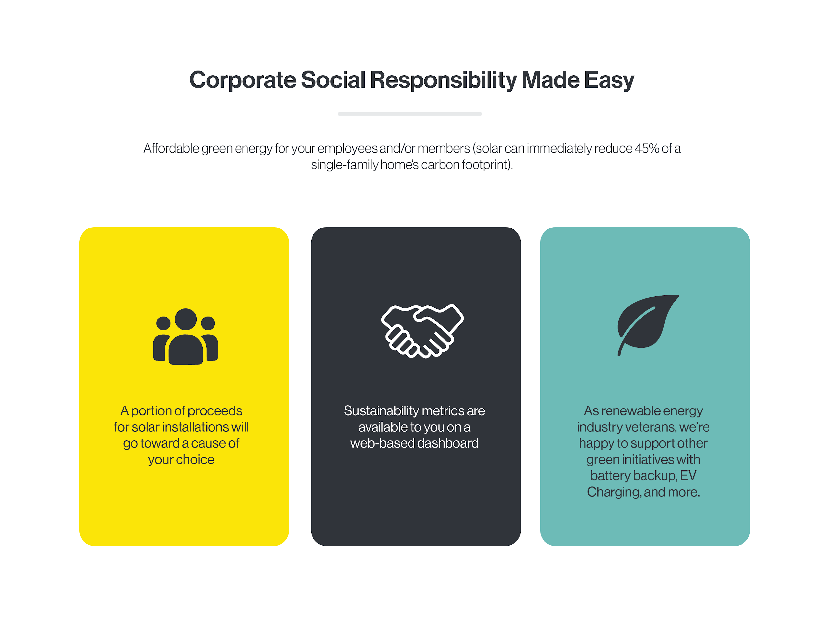

Slide 7
