Slide 1
HelioTrack Overview
Submit and track a deal

Slide 2
What is OPF?
Sales reps use HelioTrack to submit their signed customers to the system, then track their progress through the approval process.
Project managers and sales reps track the installation process using OPF.
HelioTrack
OPF
Find customer record
Upload sales files
Submit for approval
Fix missing items
SP approved
Track design
Track permitting
Track install
Track NEM
System commissioned

Slide 3
HelioTrack Can Help You...
1
2
3
Find your customer
Upload Required Files
Submit Sales Packets for Approval
4
5
View Job States
View Jobs in Jeopardy

Slide 4
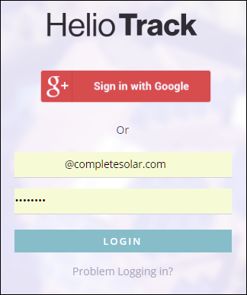
Login to HelioTrack
https://heliotrack.completesolar.com
Make sure you have your login information from you manager or Complete Solar Rep
To request a login, please fill out this form here
If you have a username, but can’t get in, click “problem logging in?”

Slide 5
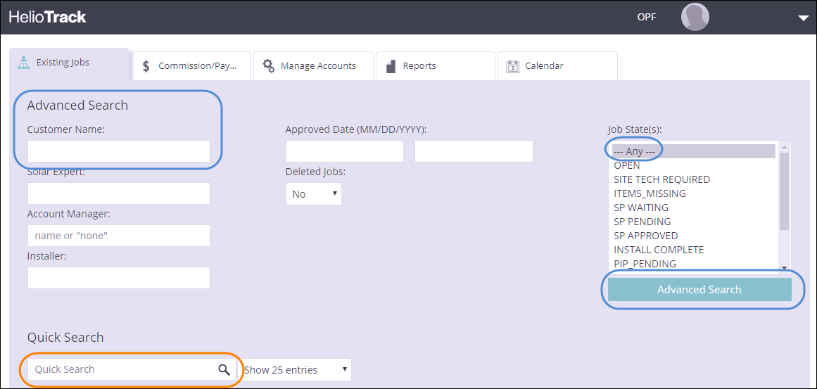
Find Your Customer in the System
Under the Existing Jobs tab you can search for a customer.
Advanced Search can search by:
customer name
current job state
or solar expert
Quick Search only searches by name
Results appear below

Slide 6
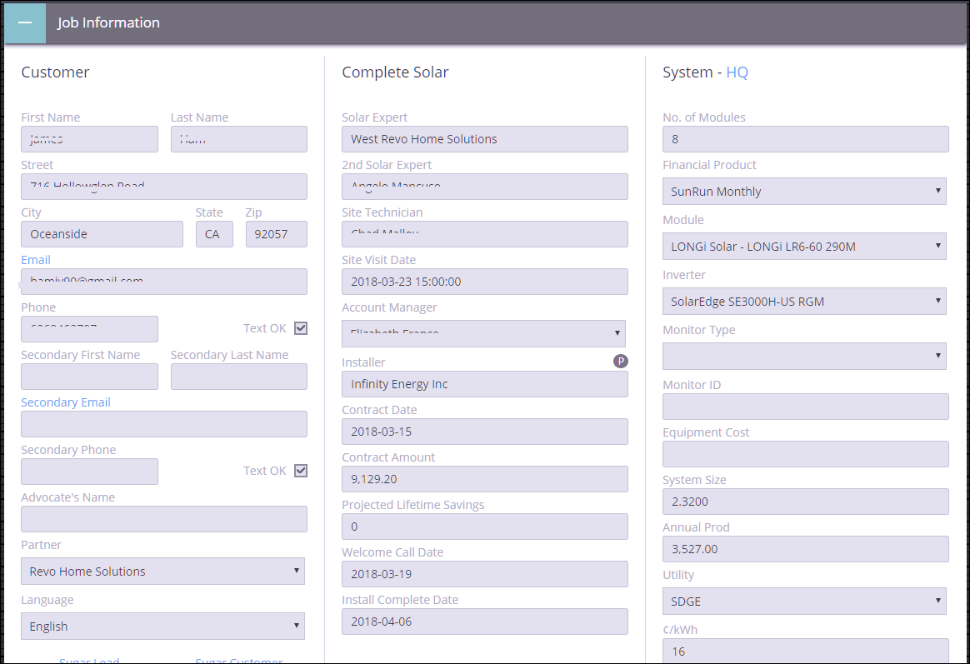
The Customer Record
The Job Information tab lists all details about your customer up to this point.

Slide 7
Sales Packet Checklist
Uploading Files

Slide 8
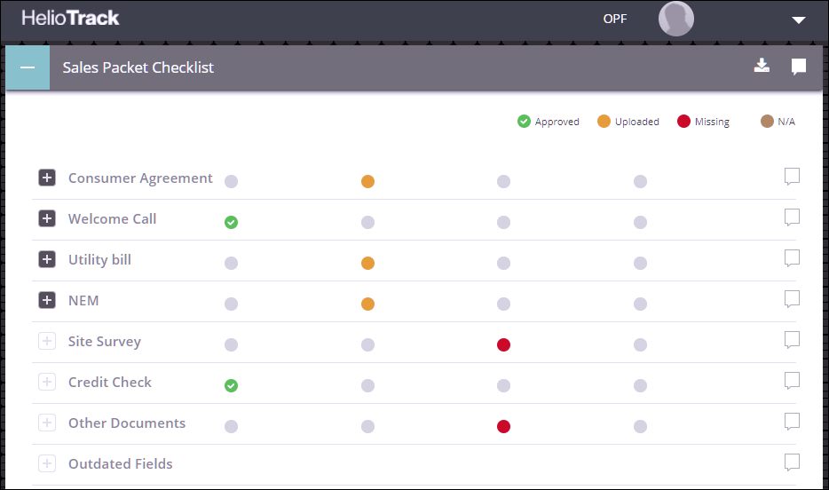
Sales Packet Checklist
Located lower on the page is the Sales Packet Checklist.
Items on the checklist are the responsibility of the sales rep and HelioDesk.
Your job will not move forward until the checklist is complete and approved

Slide 9
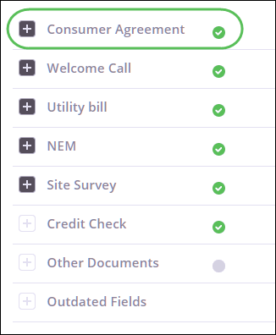
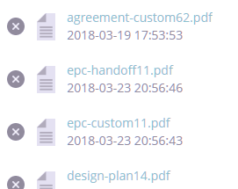
Checklist: Agreement
HelioTrack
Consumer Agreement Items include:
Cash Purchase Agreements
SunRun Agreements
LoanPal Agreements
ETC…
Other docs loaded here may include:
Financing docs
Preliminary design docs
Uploaded by HelioDesk
Most agreements are signed with DocuSign.
HelioDesk has access to all signed agreements and they will load them here.
It’s the sales rep’s responsibility to facilitate the signing of all agreements.

Slide 10
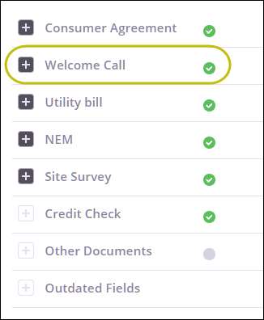
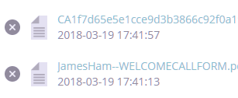
Checklist: Welcome Call
HelioDesk has access to welcome call recordings and call forms from partners.
These are uploaded by HelioDesk
It’s the sales rep’s responsibility to facilitate the Complete Solar welcome call and any welcome call required by a financing partner.
Welcome call uploads include:
Call recordings
Call forms
Uploaded by HelioDesk.

Slide 11
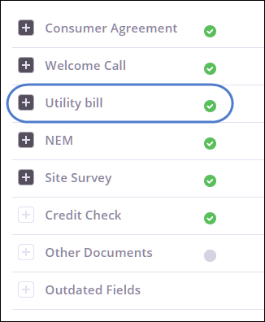
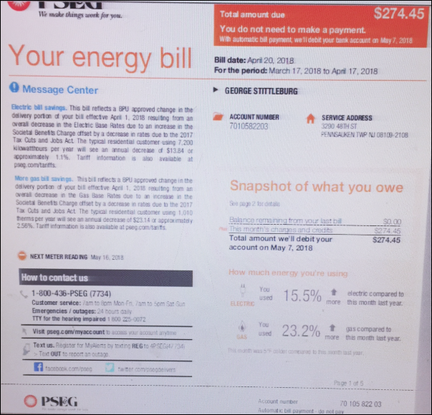
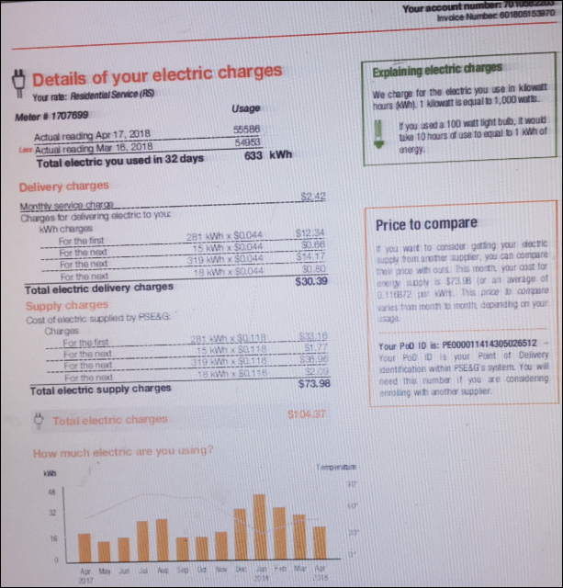
Checklist: Utility Bill
Take pictures of a customer’s utility bill, or obtain a digital copy (pdf) of their bill and upload it here.
It’s the sales rep’s responsibility to supply and upload images of the utility bill to the checklist.
Utility bill uploads may include:
Bill photos taken from your phone
Pdf’s of the bill supplied by customer
Uploaded by Sales Rep.

Slide 12
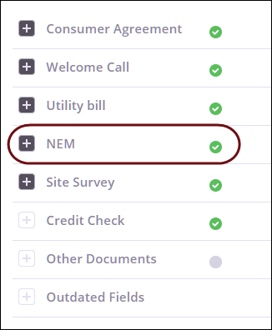
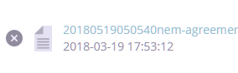
Checklist: NEM
HelioDesk will send the customer an NEM form to sign through DocuSign.
HelioDesk uploads the signed form.
Sales reps must either bring a blank NEM form, or request an NEM form be sent from HelioDesk, and then facilitate the signing.
NEM upload includes:
Signed NEM form
Uploaded by Sales Rep or HelioDesk.

Slide 13
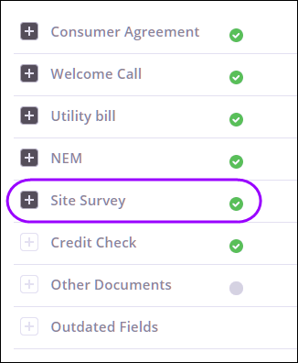
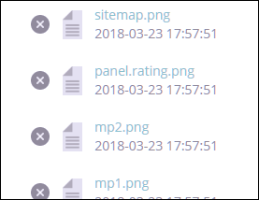
Checklist: Site Survey
A Site Tech will perform the site evaluation and supply HelioDesk with the required files
It’s the sales rep’s responsibility to schedule the Site Survey through the Complete Solar Welcome call.
Site Survey uploads include:
Roof Map
Site Worksheets
SunEye Reports
Site Photos
Structural Docs
Supplied by Site Tech
Uploaded by HelioDesk.

Slide 14
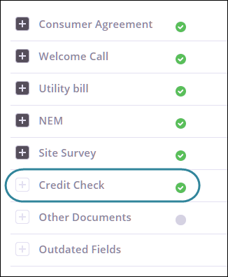
Checklist: Credit Check
Often nothing needs to be uploaded for the credit check
It’s the sales rep’s responsibility to Facilitate the credit application process with the customer.
HelioDesk will check this box when they learn the customer has passed a credit check

Slide 15
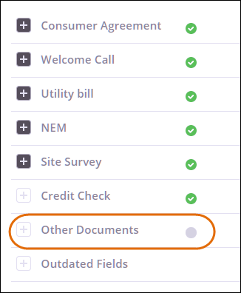
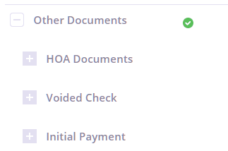
Checklist: Other Documents
These docs are sometimes required
HOA docs are supplied and signed by homeowner
Voided check is a requirement for some financing partners
Initial Payment is collected when a financing option requires a down payment
It is the sales rep’s responsibility to collect and upload any additional docs
Other Docs uploads include:
Uploaded by Sales Rep.

Slide 16
Checklist: Uploading Files
Click to expand checklist item
Drag and Drop doc
or
Select file from computer
After uploading click Save

Slide 17
Submit for Approval
Move the Job Forward

Slide 18
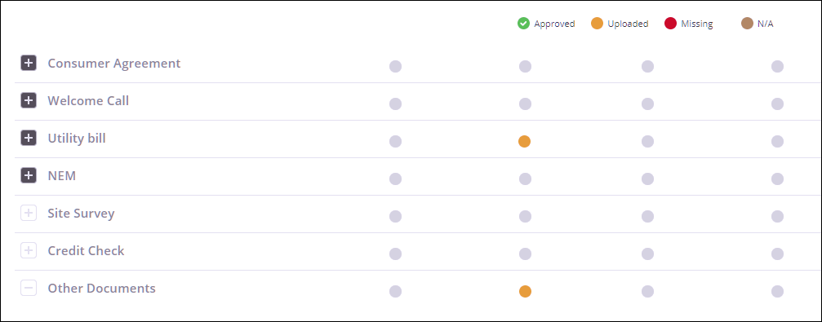
Review Checklist
After uploading docs Review the checklist:
Has customer signed all agreements?
Have you completed all welcome calls?
Have you collected and uploaded a utility bill?
Has customer signed a NEM?
Scheduled Site Survey?
Completed credit check?
Collected any additional docs?

Slide 19
Submit for Approval
Once you’re sure you’ve done everything required of you on the checklist…
Click Save and Submit at the bottom of the page
Your job won’t move forward unless you click Submit

Slide 20
Job States
Keep Tabs on Your Deal

Slide 21
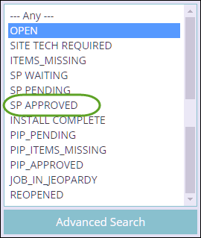
Job States
All jobs in HelioTrack are divided into Job States.
All new customers and customers-at-signing have the Open job state.
Your goal with a recently signed customer is to get them to the SP Approved state.
SP = Sales Packet
PIP = Post Install Project

Slide 22
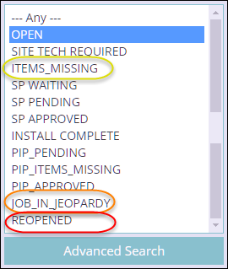
Job States (Cont.)
It’s not always a smooth road to approval and installation.
States to avoid include:
Items Missing
Job in Jeopardy
Re-opened

Slide 23
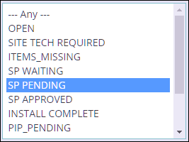
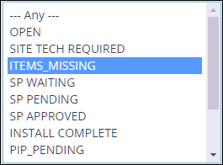
Approval Process
When you submit a job, the Job State moves to Sales Packet Pending/Waiting
Waiting: An auditor hasn’t reviewed it yet
Pending: An auditor is currently reviewing it
If something prevents approval, the auditor will move it to Items Missing

Slide 24
Items Missing
Unfortunately there are hundreds of jobs in items missing.
Easy fixes:
Missing utility bill
Missing NEM
More difficult:
Re-sign needed (design or financing reasons)
Roof work needed
Be sure to check for identified missing items in the Comments and Checklist sections

Slide 25
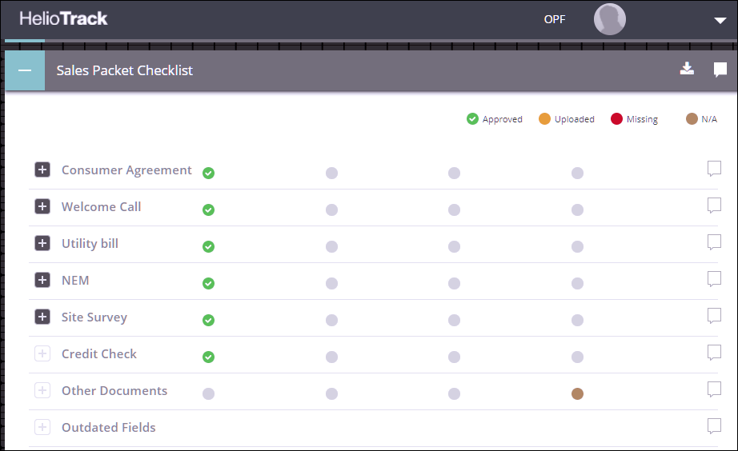
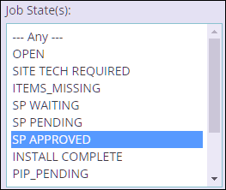
Approval
Once all items are completed and approved, an auditor will update the job state to Sales Packet Approved.

Slide 26
Job in Jeopardy
Save this Job!

Slide 27
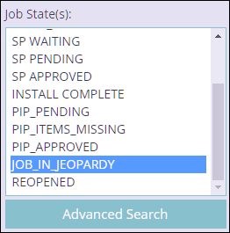
Job in Jeopardy
‘JIJ’ is a short list of jobs that need to be saved now.
Jobs move to JIJ when problems arise after sales packet approval.
These jobs are in Jeopardy of being reopened, which will result in starting the approval process over from the beginning, and likely re-signing the customer.

Slide 28
Job in Jeopardy (Cont.)
Possible reasons for JIJ:
Customer may change their mind and request to cancel
Problems related to the site may fatally complicate a job
Complication may delay progress to the point of JIJ

Slide 29
Job in Jeopardy Section
In the Job in Jeopardy section: Hover over the ‘Issue’ field to a view the specific reason why the job is in jeopardy
In the Job in Jeopardy section: Hover over the ‘Issue’ field to a view the specific reason why the job is in jeopardy

Slide 30
Next Steps
Post Approval

Slide 31
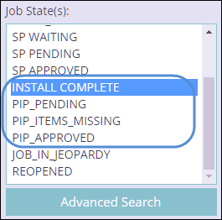
Tracking Post-Approval
The road to installation and commissioning of a PV system is complicated.
This can’t be tracked with job states alone.
Post Approval, jobs are tracked with another tool called OPF which is covered in the next lesson.

Slide 32
End of Lesson

